Slide 1

Anomaly Detection in Spacecraft Telemetry
ITAI 2372 Final Project-Conceptual Design Track
Authors Jazmine Brown & Troy Nsofor

Slide 2
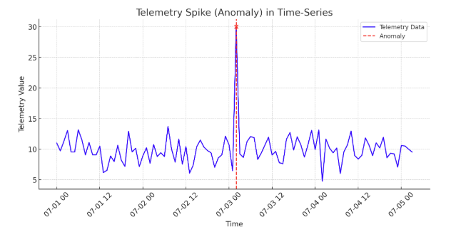
Problem Statement
Spacecraft telemetry (e.g., temperature, pressure, voltage) is critical for mission success.
Anomalies in data can signal potential system failures, risking safety and efficiency.
Manual monitoring is slow and error-prone for large datasets.

Slide 3
Project Objective
Develop an AI-based system to detect anomalies in real-time telemetry data.
1
Goal: Improve mission safety and operational efficiency for NASA.
2
Scope: Conceptual design focusing on feasibility and approach.
3

Slide 4
Proposed Solution
We propose an AI-based anomaly detection system to identify irregularities in spacecraft telemetry data. The system will use machine learning techniques, specifically an Isolation Forest algorithm or Long Short-Term Memory (LSTM) neural networks, to analyze time-series telemetry data. The system will:
Collect real-time sensor data (e.g., temperature, pressure, voltage).
Preprocess data to handle noise and missing values.
Train an AI model to detect anomalies by learning normal patterns and flagging deviations.
Alert mission control when anomalies are detected, enabling rapid response.
The solution leverages existing AI frameworks like scikit-learn or TensorFlow (for LSTM), ensuring feasibility and scalability.

Slide 5
Technical Approaches
Statistical Methods:
Threshold: Setting top and bottom limitations for telemetry benefits. Deviations trigger alerts.
Percentiles and IQR: Spotting data points outside the main percentile or interquartile ranges.
Time series analysis: Examining trends, seasonality, and residuals to discover deviations from expected patterns.
Machine Learning:
Supervised Learning: Training models on labeled evidence to spot new data. Examples are decision trees, logistic regression, and neural networks.
Unsupervised Learning: Spotting anomalies with no labeled data by discovering deviations from learned patterns. Grouping, dimensionality reductions, and autoencoders are unique techniques.

Slide 6
More technical Approaches
Deep Learning:
Recurrent Neural Networks (RNNs), especially LSTMs: Suitable for time series evidence, getting the common dependencies in telemetry.
Autoencoders: Understand compressed symbolizations of normal evidence, and anomalies are discovered based on reconstruction mistakes.
Graph Neural Networks: Designing relationships among opposite telemetry channel and discovering anomalies based on network behavior.
Other Techniques:
Ensemble methods: Putting together a ton of algorithms to improve correction and robustness.
Reconstruction-based methods: Using the autoencoders or other strategies to rebuild the telemetry evidence and discover anomalies based on rebuilding mistakes.

Slide 7
Testing Plan
Testing Plan: AI-Based Anomaly Detection in Spacecraft Telemetry Data
Testing Goals
Confirm the system detects anomalies with high precision and recall
Ensure robustness against noisy or incomplete telemetry data
Verify real-time performance
Address interpretability by providing clear, actionable alerts.

Slide 8
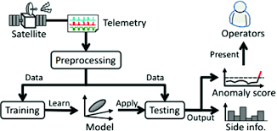
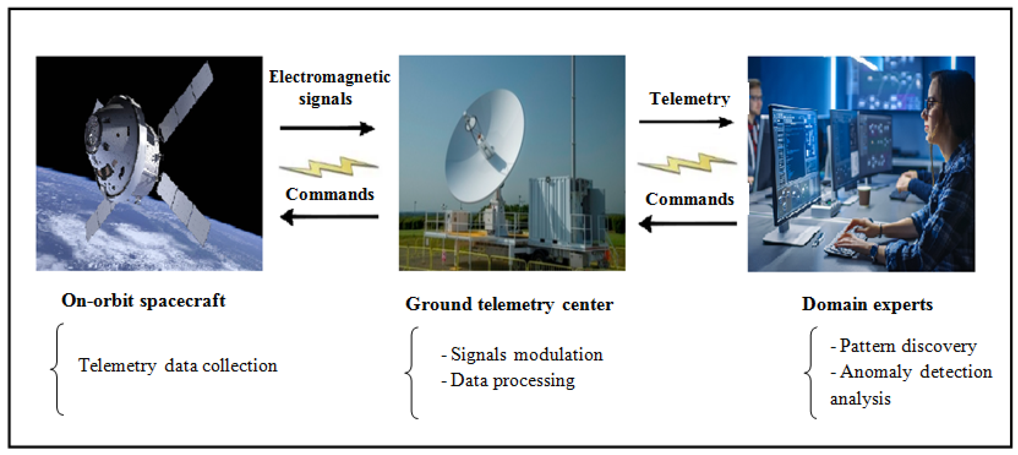
THE TESTING PLAN

Slide 9
Test data
Test Data
Sources:
Simulated telemetry: NASA's public datasets (e.g., SMAP or Curiosity rover telemetry).
Synthetic data: Generate time-series with injected anomalies
Characteristics:
Normal data: 80% of dataset
Anomalous data: 20% with labeled anomalies
Edge cases: 10% missing values, Gaussian noise, or extreme readings

Slide 10
More other test data
Data Split
Training: 70%
Validation :15%
Testing:15%

Slide 11
Testing methods
Unit Testing:
Preprocessing: Verify data cleaning, normalization, and windowing.
Isolation Forest: Ensure model outputs anomaly scores for static data.
LSTM Autoencoder: Confirm reconstruction errors are generated for time-series inputs.
Alert System: Test API delivers JSON alerts with correct format
2. Integration Testing:
Test end-to-end pipeline: Telemetry input to preprocessing to model to alert output
Verify API integration with a mock mission control dashboard.

Slide 12
testing methods
3. Performance Testing:
Measure latency: Process 1,000 data windows; target <1 second per window.
Test scalability: Run on 1 million data points to ensure no crashes.
4. Robustness Testing:
Test edge cases: Missing data, noisy data, or corrupted inputs.
Verify model performance under adverse conditions

Slide 13
Evalutation metrics
Primary Metrics:
Precision: Percentage of flagged anomalies that are true
Recall: Percentage of true anomalies detected
F1-Score: Harmonic mean of precision and recall

Slide 14
Secondary metrics
False Positive Rate: Normal data flagged as anomalous
Latency: Processing time per window
Threshold Tuning:
Isolation Forest: Adjust contamination parameter using validation data
LSTM: Tune reconstruction error threshold to optimize F1-score.

Slide 15
TEST scenarios
Normal Operation:
Input: Normal telemetry (e.g., stable temperate, voltage).
Expected: No alerts; Isolation Forest scores <0.7; LSTM errors below threshold.
2. Known Anomaly:
Input: Data with injected anomaly
Expected: Alert triggered with correct details

Slide 16
More test scenarios
3. Edge Case:
Input: Data with 10% missing values or added noise
Expected: Recall >85%; alerts remain accurate.
4. High Load:
Input: Continuous 24-hour telemetry stream
Expected: System processes data in real time without crashes; latency <1 second.

Slide 17
Testing process
Setup:
Prepare test datasets
Deploy models on a test server mimicking NASA's environment
2. Execution:
Run unit tests on preprocessing, models, and alerts.
Conducts integration tests on the full pipeline.
Perform performance and robustness test with edge cases.

Slide 18
More testing processes
3. Analysis:
Calculate metrics for each scenario
Log results in docs/test_results.md with tables and visualizations
4. Iteration:
If the metrics fall below targets, adjust model parameters or preprocessing.
Retest until targets are met.

Slide 19
ADDress challenges
Data Quality
Test preprocessing robustness with noisy or incomplete data.
Use isolation Forest as a fallback for low-quality data scenarios.
Real-Time Constraints:
Optimize LSTM inference and leverage isolation Forest's speed.
Measure latency in high-load tests to ensure <1 second processing.
Model Interpretability:
Include visualizations in alerts.
Provide confidence scores and sector details to aid mission control.

Slide 20
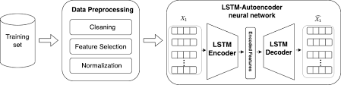
LSTM Autoencoder
LSTM Autoencoder takes 60-second time-series windows, learns normal telemetry patterns and flags anomalies when reconstruction errors exceed a threshold. Outputs anomaly scores and alerts like Isolation Forest.

Slide 21

Model training details
Train Isolation Forest on mixed normal/anomalous data (e.g., NASA’s SMAP dataset) using scikit-learn, tuning contamination to 0.1. Train LSTM Autoencoder on normal telemetry only, using 70% of data for training and 15% for validation. Use AWS EC2 or local GPU for processing.

Slide 22
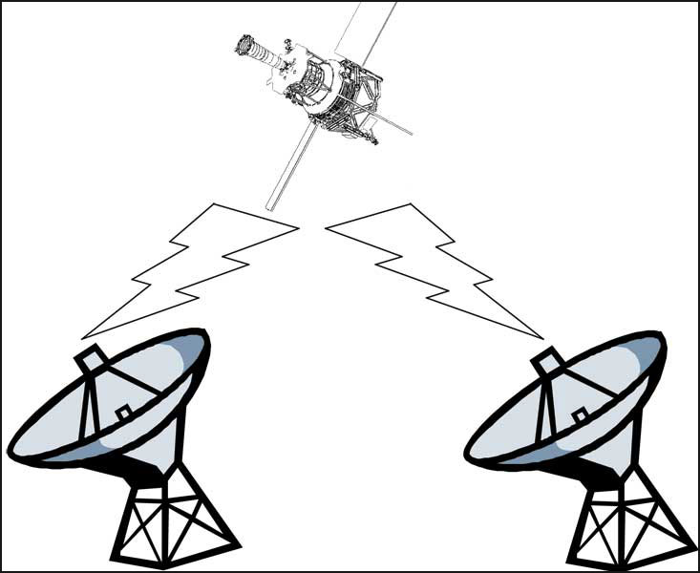
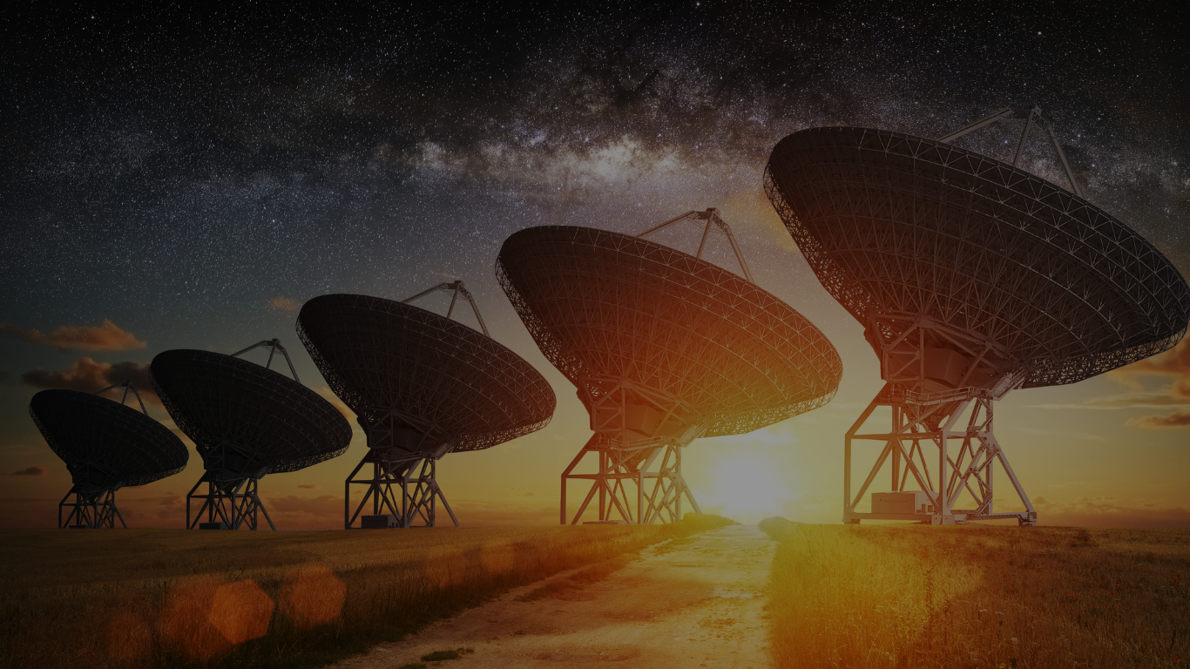
Integration with Mission Control
Models connect to NASA’s mission control via a REST API, sending JSON alerts. Alerts display on a dashboard with time-series plots. Uses Flask for API development.

Slide 23
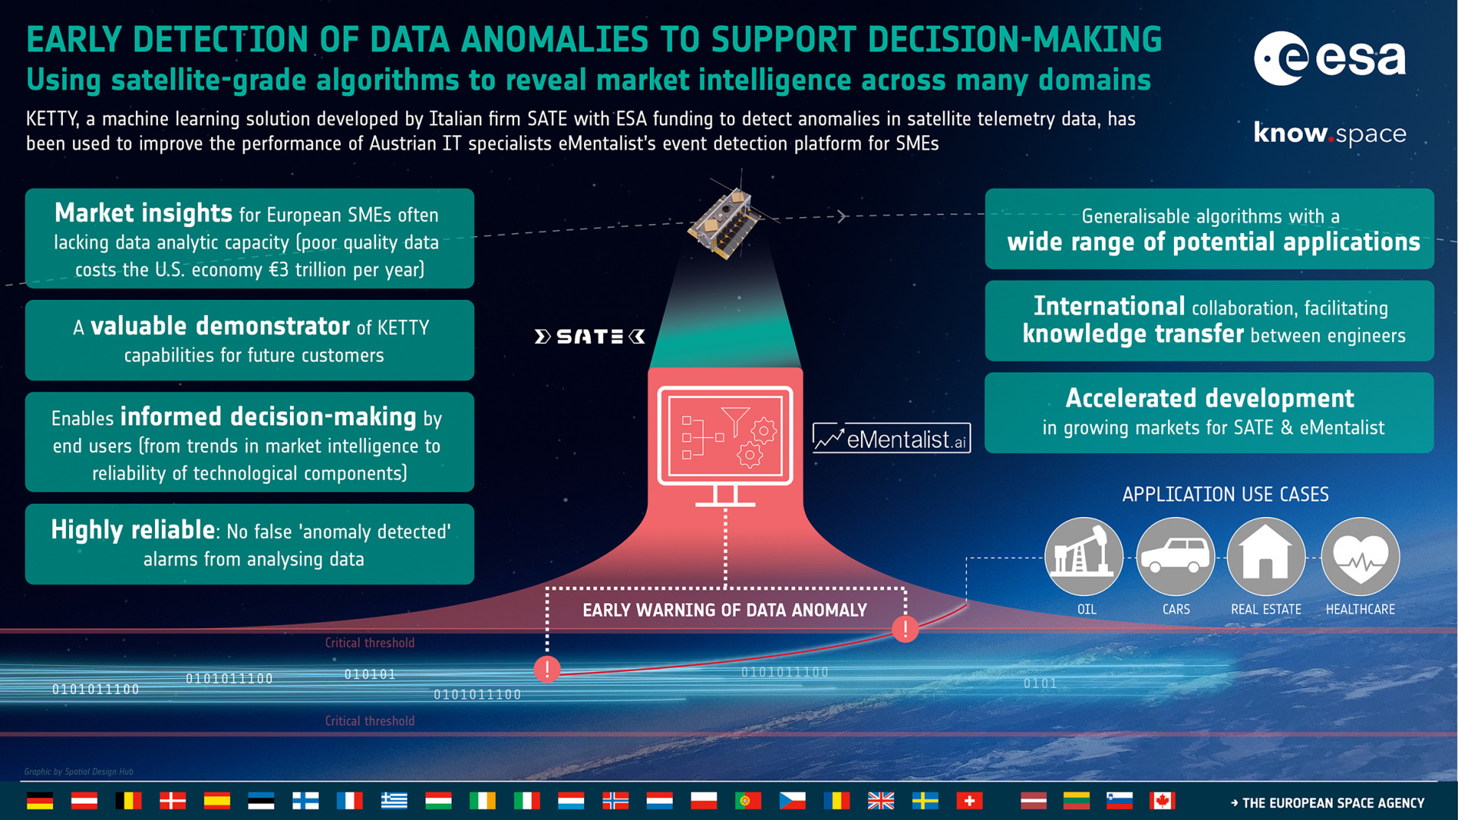
Challenges and Solutions
Noisy data handled by robust preprocessing (e.g., interpolation for 10% missing values). Real-time constraints met by optimizing LSTM inference (e.g., model quantization) and using Isolation Forest’s speed. Interpretability improved with visualizations (e.g., anomaly plots) and confidence scores in alerts.”

Slide 24
Expected outcomes
System achieves >90% precision, >95% recall, and <5% false positives.
Process telemetry in real time (<1 second latency).
Robust to edge cases, maintaining >85% recall in noisy conditions.
Providers clear, interpretable alerts for mission control.

Slide 25
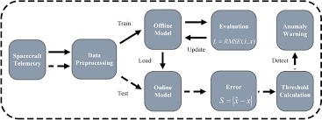
The Steps
Anomaly detection with the spacecraft telemetry includes the main steps:
Data collection and Preprocessing
Selecting appropriate anomaly detection techniques
Model development and training
Testing and Validation
Deployment and Continuous monitoring

Slide 26
Conclusion
“This hybrid AI system ensures robust anomaly detection, enhancing spacecraft safety and efficiency across NASA missions.” This AI-based anomaly detection system addresses a crucial requirement in spacecraft operations by automating the identification of serious problems in telemetry evidence. By leveraging created AI techniques, the solution is practical and adaptable, introducing important advantages to NASA's mission success.

